Slide 1
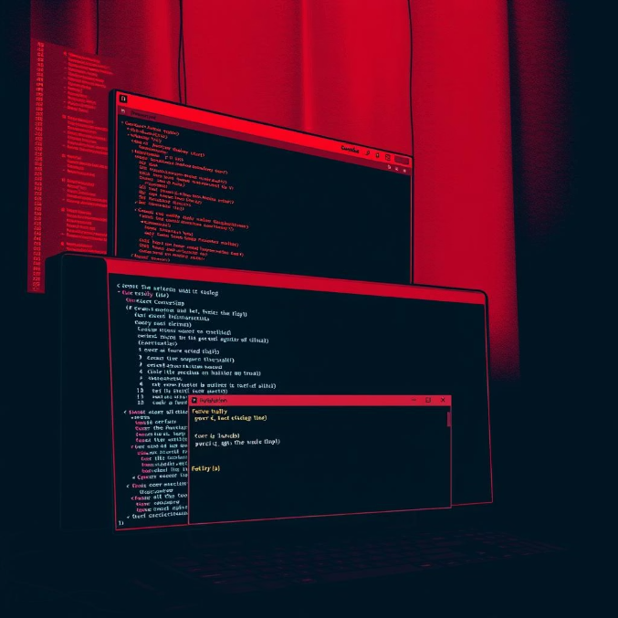

Word Search Generator
A project of CSE115.
Group 10: Nakib Uddin Azadi,Fariba Ahmed,Tawsif Al Imam Ayon,Safwat Sadiq,Toufiq Omar.

Slide 2


Meet Group 10
Nakib Uddin Azadi
Fariba Ahmed
2231171043
2512627642
Tawsif Al Imam Ayon
Safwat Sadiq
2513269642
2513454642
Toufiq Omar
2512194643
Group 10: Nakib Uddin Azadi,Fariba Ahmed,Tawsif Al Imam Ayon,Safwat Sadiq,Toufiq Omar.

Slide 3
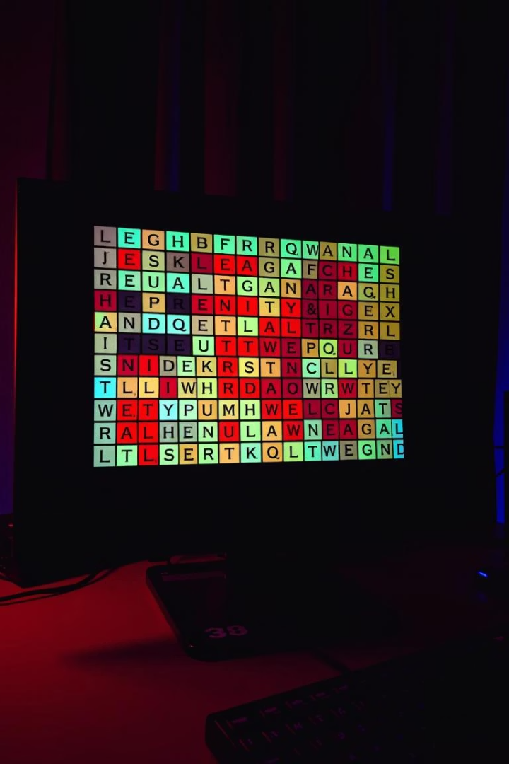
Word Search Generator in C
Simple yet engaging puzzle game
Random words placed on a grid
Find and remove words in real-time
Brain-boosting word challenge
Group 10: Nakib Uddin Azadi,Fariba Ahmed,Tawsif Al Imam Ayon,Safwat Sadiq,Toufiq Omar.

Slide 4






Why This Project?
Boosts Vocabulary
Fun Real-time Play
Efficient Algorithms
Custom 20x20 Grid
Group 10: Nakib Uddin Azadi,Fariba Ahmed,Tawsif Al Imam Ayon,Safwat Sadiq,Toufiq Omar.

Slide 5

From Words to Puzzle
Grid setup
Place words
Fill empty spots
User Interaction
Prepare empty puzzle canvas
Random positions and directions
Random letters fill blanks
Find and remove words visually
Group 10: Nakib Uddin Azadi,Fariba Ahmed,Tawsif Al Imam Ayon,Safwat Sadiq,Toufiq Omar.

Slide 6
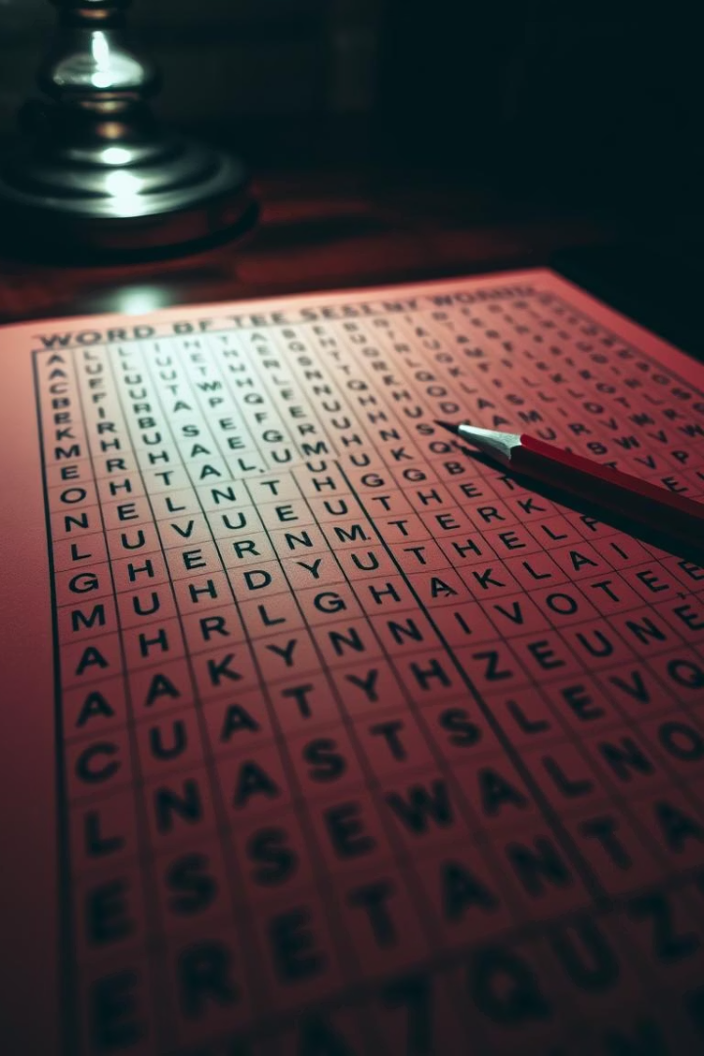

How Words Are Placed
1
Random position + direction
2
Overlap/conflict checks
3
Retries until fit
4
Fill empty slots randomly
Group 10: Nakib Uddin Azadi,Fariba Ahmed,Tawsif Al Imam Ayon,Safwat Sadiq,Toufiq Omar.

Slide 7
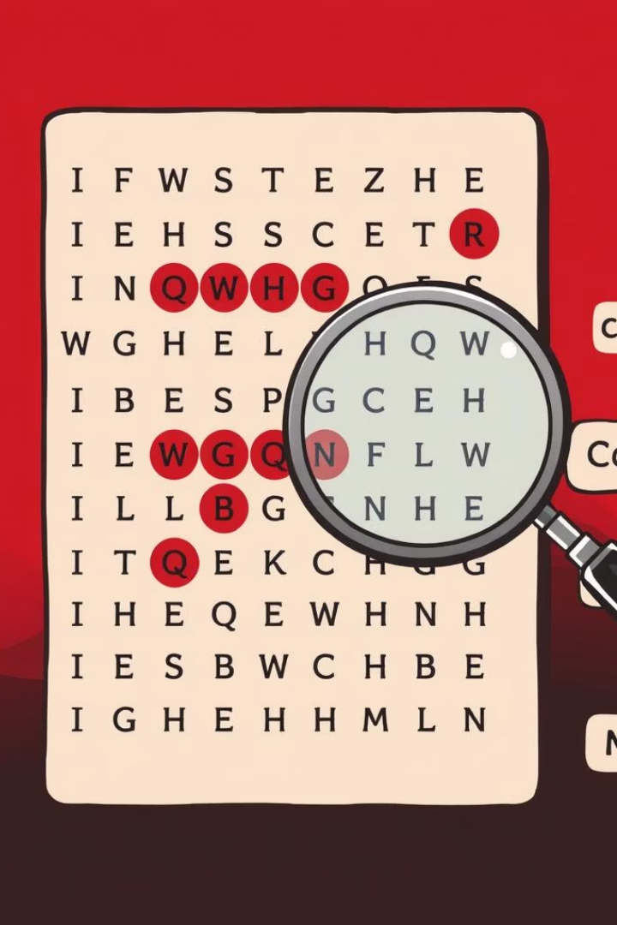




How Words Are Removed
Checking
The program checks all the directions of the grid.
Comparing
Then it compares word characters with grid characters.
Matching
If word matches, it replaces matching characters with "."
Group 10: Nakib Uddin Azadi,Fariba Ahmed,Tawsif Al Imam Ayon,Safwat Sadiq,Toufiq Omar.

Slide 8
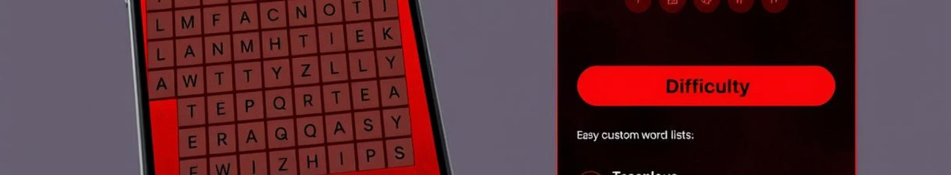





Tough Bits We Tamed
Overlapping word handling
Retry logic implementation
Directional placement rules
Interactive gameplay design
Group 10: Nakib Uddin Azadi,Fariba Ahmed,Tawsif Al Imam Ayon,Safwat Sadiq,Toufiq Omar.

Slide 9
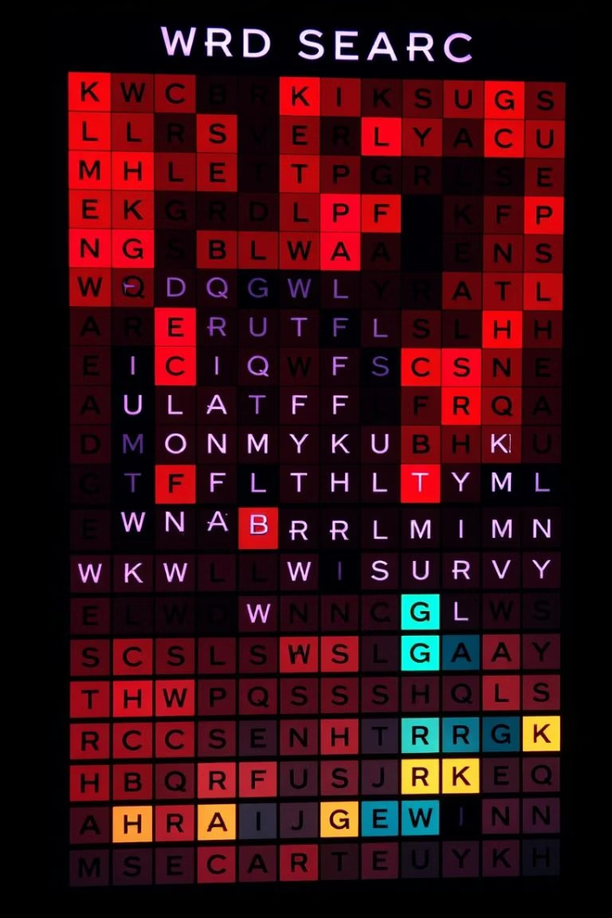
Does It Work?
Heck Yes !
Passed all tests: correct word placement, scoring, responsive feedback
Group 10: Nakib Uddin Azadi,Fariba Ahmed,Tawsif Al Imam Ayon,Safwat Sadiq,Toufiq Omar.

Slide 10







Future Upgrades
Timer Feature
Difficulty Levels
Custom Word List
Menu System
Group 10: Nakib Uddin Azadi,Fariba Ahmed,Tawsif Al Imam Ayon,Safwat Sadiq,Toufiq Omar.

Slide 11


Takeaway
Learning meets fun. Built with logic, designed for challenge.
Word game that sharpens minds and skills.
Group 10: Nakib Uddin Azadi,Fariba Ahmed,Tawsif Al Imam Ayon,Safwat Sadiq,Toufiq Omar.

Slide 12

Thank You
We appreciate your time and interest in our Word Search Generator project.
Feel free to ask questions or share your feedback.
Questions?
Feedback Welcome
We are here to clarify and discuss any details.
Your input helps us improve and grow this project.
Group 10: Nakib Uddin Azadi,Fariba Ahmed,Tawsif Al Imam Ayon,Safwat Sadiq,Toufiq Omar.

